Slide 1
Automated Parametric Optimization of an HPGe MCNP Model
Bryan V. Egner
Graduate Student
Department of Engineering Physics, AFIT
Bryan.Egner@afit.edu
Notes:
HPGes/Applications
NucE world modeling for everything
Some sources are hard to predict, models provide insight to make intelligent experimental decisions, cut costs, plausibility
Raise flags on possible detector issues
Future template for future exp. With this detector
Detection and Measurement Saturday, April 7, 8:00am - 9:20am Room: Reitz Union Room 2330 All presentations are taking place in the Reitz Union. You will find the exact order you will be presenting within a session in the conference program. Please arrive at least 15 minutes before the session starts. For instance if the session goes from 10:00 AM - 11:20 AM please be in the session room at 9:45 AM. Additionally, you are expected to stay in the session the entire time. When you arrive in the room meet with the session chair and load your presentation onto the computer in the room. It is highly recommended that you bring your presentation on a flash drive in a PDF format. To reiterate, please export your PowerPoint into a PDF. There are less compatibility issues this way. You will have 15 minutes to present with 5 minutes for a Q/A sessions.

Slide 2
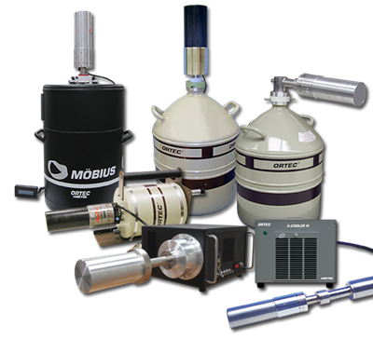
Overview
Project Goals
Experimental Setup
MCNP Model
Automated Parametric Optimization
Results
Conclusions
Future Work
Notes:
Goals, Lit, Exp, Model, optimize, results, conc.

Slide 3
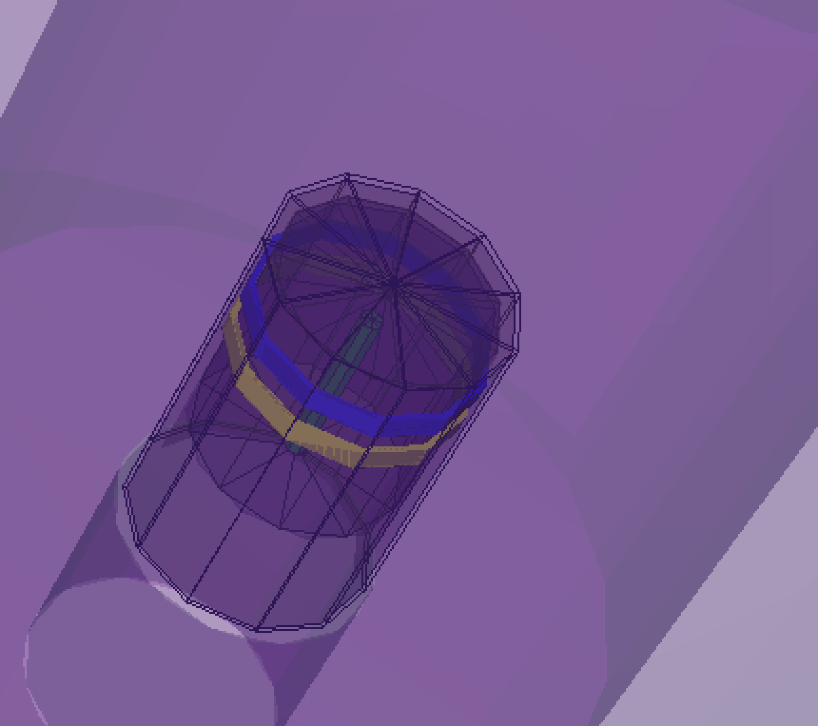
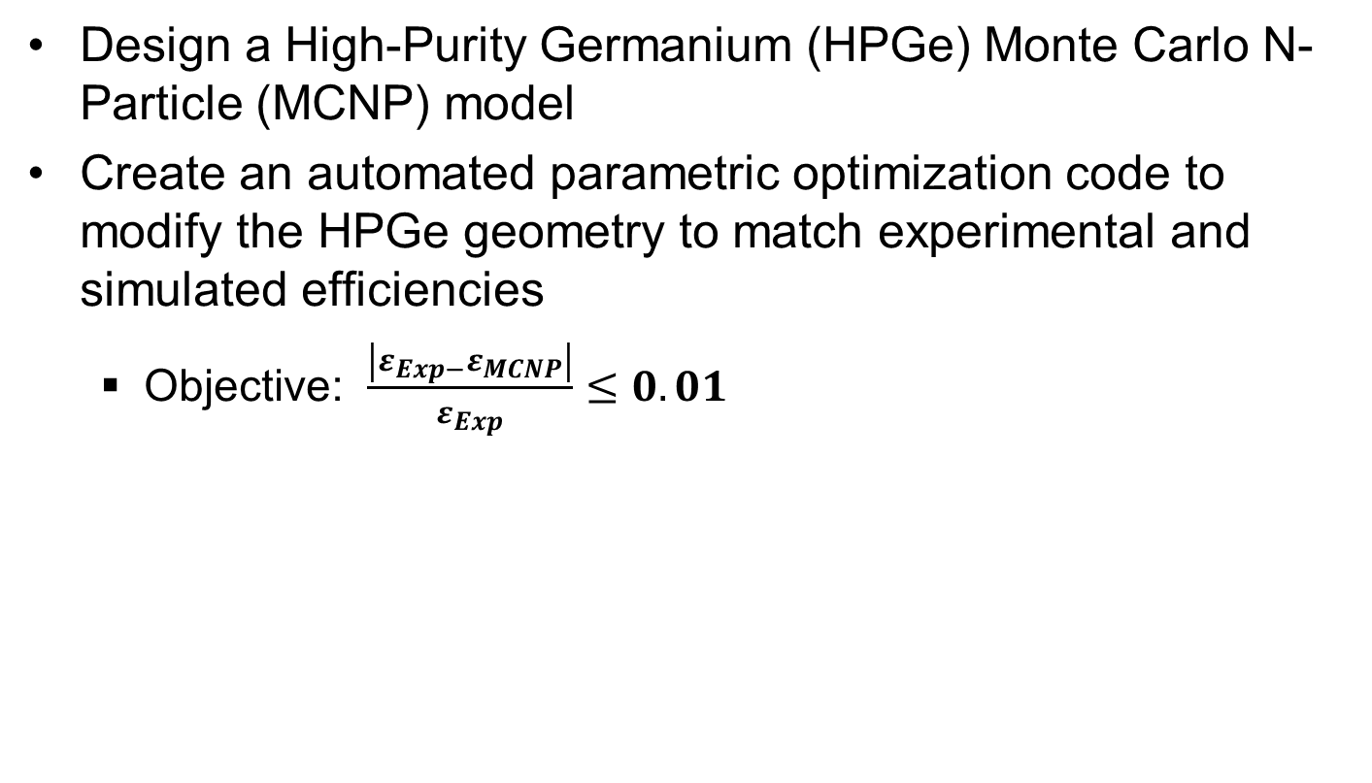
Project Goals
Design a High-Purity Germanium (HPGe) Monte Carlo N-Particle (MCNP) model
Create an automated parametric optimization code to modify the HPGe geometry to match experimental and simulated efficiencies
Objective: $\frac{\left|ε_{Exp−}ε_{MCNP}\right|}{ε_{Exp}}≤0.01$
Notes:
Model
Automated Optimization

Slide 4
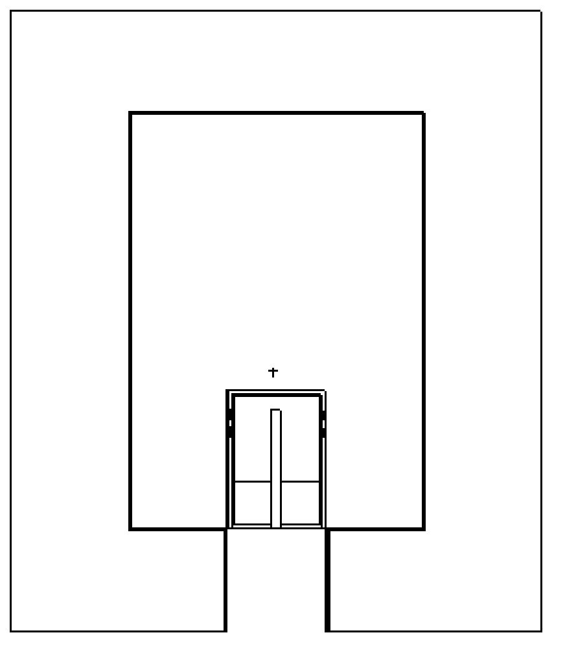
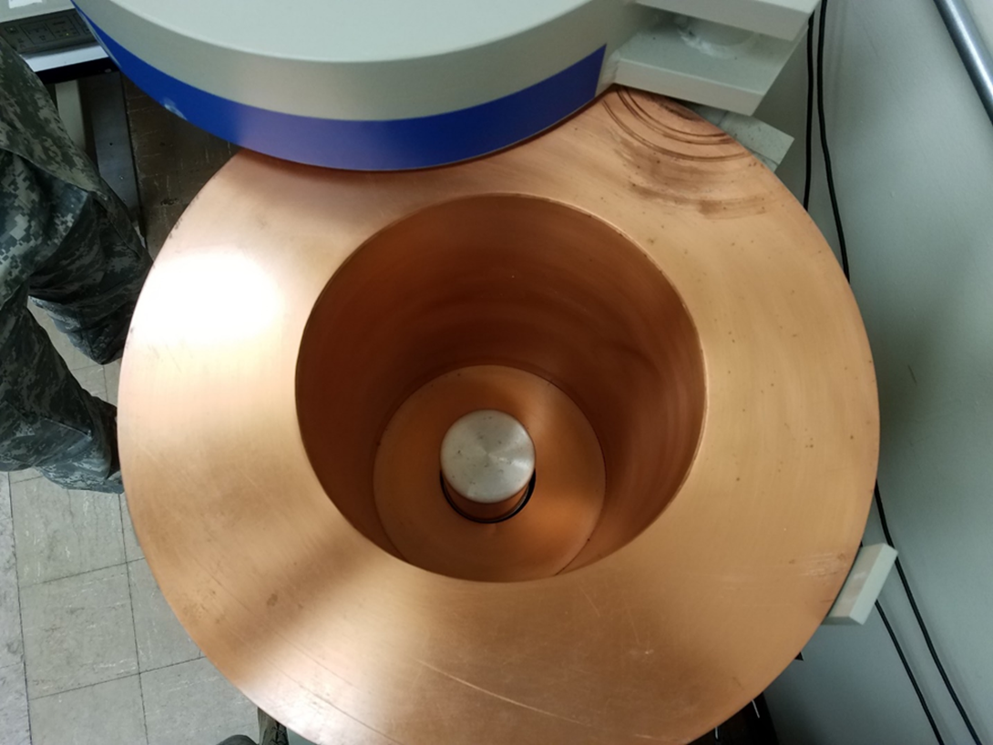
Experimental Setup
- Five source positions
- 24-hour measurements
Z-axis
G
5
3
A – 13.74 cm
B – 3.48 cm
C – 4.89 cm
D – 7.60 cm
E – 20.74 cm
F – 29.74 cm
G – 9.78 cm
E
F
1
B
2
A
C
4
D
X-axis
(0,0)
Notes:
Visual set up

Slide 5
Experimental Setup
Gamma-Ray Energy [keV] | Nuclide | Activity [µCi] | Gammas per Second
60 | Am-241 | 0.02941 | 391.7
88 | Cd-109 | 0.2707 | 363.6
122 | Co-57 | 0.01019 | 322.7
159 | Te-123 | 0.01403 | 436.1
320 | Cr-51 | 0.3389 | 1236
392 | Sn-113 | 0.05109 | 1227
514 | Sr-85 | 0.06171 | 2247
662 | Cs-137 | 0.04325 | 1362
898 | Y-88 | 0.09633 | 3347
1173 | Co-60 | 0.05101 | 1885
1333 | Co-60 | 0.05101 | 1887
1836 | Y-88 | 0.09622 | 3539
Energies were kept consistent with manufacturer provided documentation
Source uncertainty for each energy was 3.1% at the 99% confidence level
Eckert & Ziegler Multi-nuclide source, 0.9665 µCi, 1-Nov-2016.
Notes:
Short Half-Lives:
Te-123m(119days), Cr-51(28 days), Sn-113(115 days), Sr-85(65 days), Y-88(106 days)

Slide 6
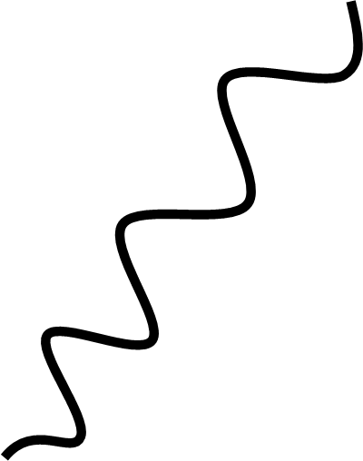

Detector Specifications
Canberra Standard Electrode Ge Detector (SEGe)
Model Number: GC10021
Relative Efficiency $≥$ 100 %
Resolution: 1.20 keV at 122 keV and 2.1 at 1.3 MeV
Coaxial Configuration
83 mm Diameter
84.5 mm Length
P-Type
γ
p+ contact
n+ contact
e-
Ge Crystal
Notes:
Found on Canberra’s website

Slide 7
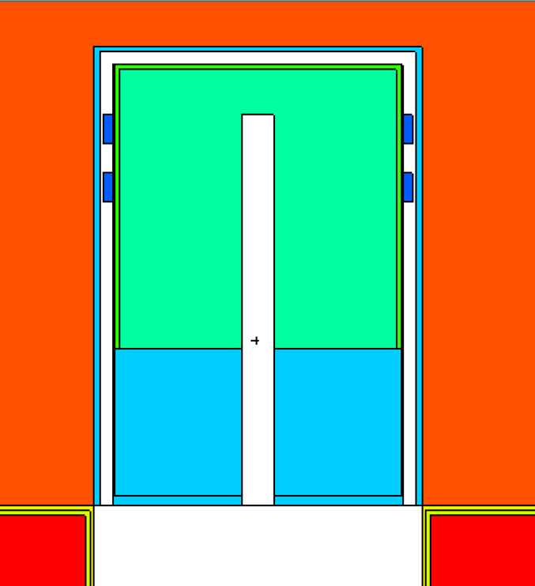
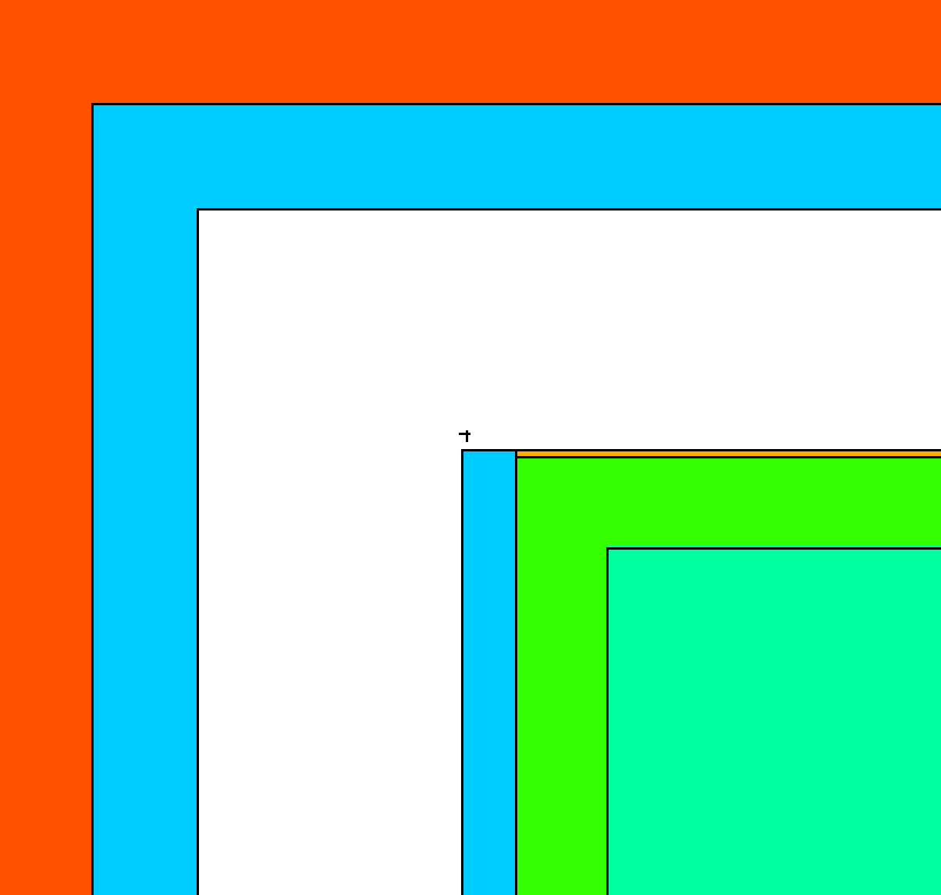
MCNP Model Geometry
Origin: Centered/Bottom of shielding case
Cylinders (~14 CZs)
Planes (~20 PZs)
Air
Inner Deadlayer
Air
Metal Clasps
Al Casing
Ge Crystal
Vacuum
IR Window
Outer Deadlayer
Air
Ge Crystal
Al Holder
Vacuum
Notes:
Cylinders/Planes to simplify parameter/size adjustments
Interchangeable for future models
Photon Transport:
Only photons
5 MeV upper limit
No Bremsstrahlung
No Coherent scattering
No photo fission
Doppler broadening
Source Definition:
Isotropic point source
12 discrete energies
5*10⁶ source particles
Gaussian broadening off
Tally:
F8 – Energy Deposition Tally
Ge Crystal (Cell 3)
8192 bins (10⁻⁵ - 3.14344 MeV)

Slide 8
MCNP Model Parameters
Parameter | Initial Value | Lower Bound | Upper Bound
Outer Top Deadlayer [cm] | 0.13 | 0.013 | 0.739
Outer Sides Deadlayer [cm] | 0.13 | 0.03 | 0.23
Ge Crystal Length [cm] | 8.32 | 7.47 | 9.17
Kapton Window [cm] | 0.01 | 0.005 | 0.110
Inner Top Coaxial Deadlayer [cm] | 3E-05 | 5.7E-06 | 1.3E-4
Inner Sides Coaxial Deadlayer [cm] | 3E-05 | 1E-05 | 1E-4
Top Al Casing Thickness [cm] | 0.15 | 0.05 | 0.25
Sides Al Casing Thickness [cm] | 0.15 | 0.05 | 0.25
Ge Crystal Density [g/cm³] | 5.32 | 5.29 | 5.32

Slide 9
Automated Parametric Optimization
User Input
Output
Parametric Optimization
Base MCNP Model
Variable Inputs/Parameters
Experimental Data
Build MCNP Decks
Chi-Squared Minimization
MCNP Output Files
Absolute Efficiency Comparison
Run MCNP
Notes:
Schematic Overview
InputDeck – Location of the created MCNP Decks
MCNP_Ouput – Location of the created data
Model – Location of the user created MCNP deck
Experimental Data
FilestoMerge
Required Software:
MCNP - 6
Python – 3
How-to run - Known working with python installed on local C: double click the StartAutomaton.bat
Otherwise use favorite IDE and run the python script
User Input:
Base MCNP Model:
Generic Section
Source Geometry Section
Variable Input/Parameters
Initial Parameter
Parameter Bounds
Experimental Absolute Efficiencies with Uncertainties

Slide 10
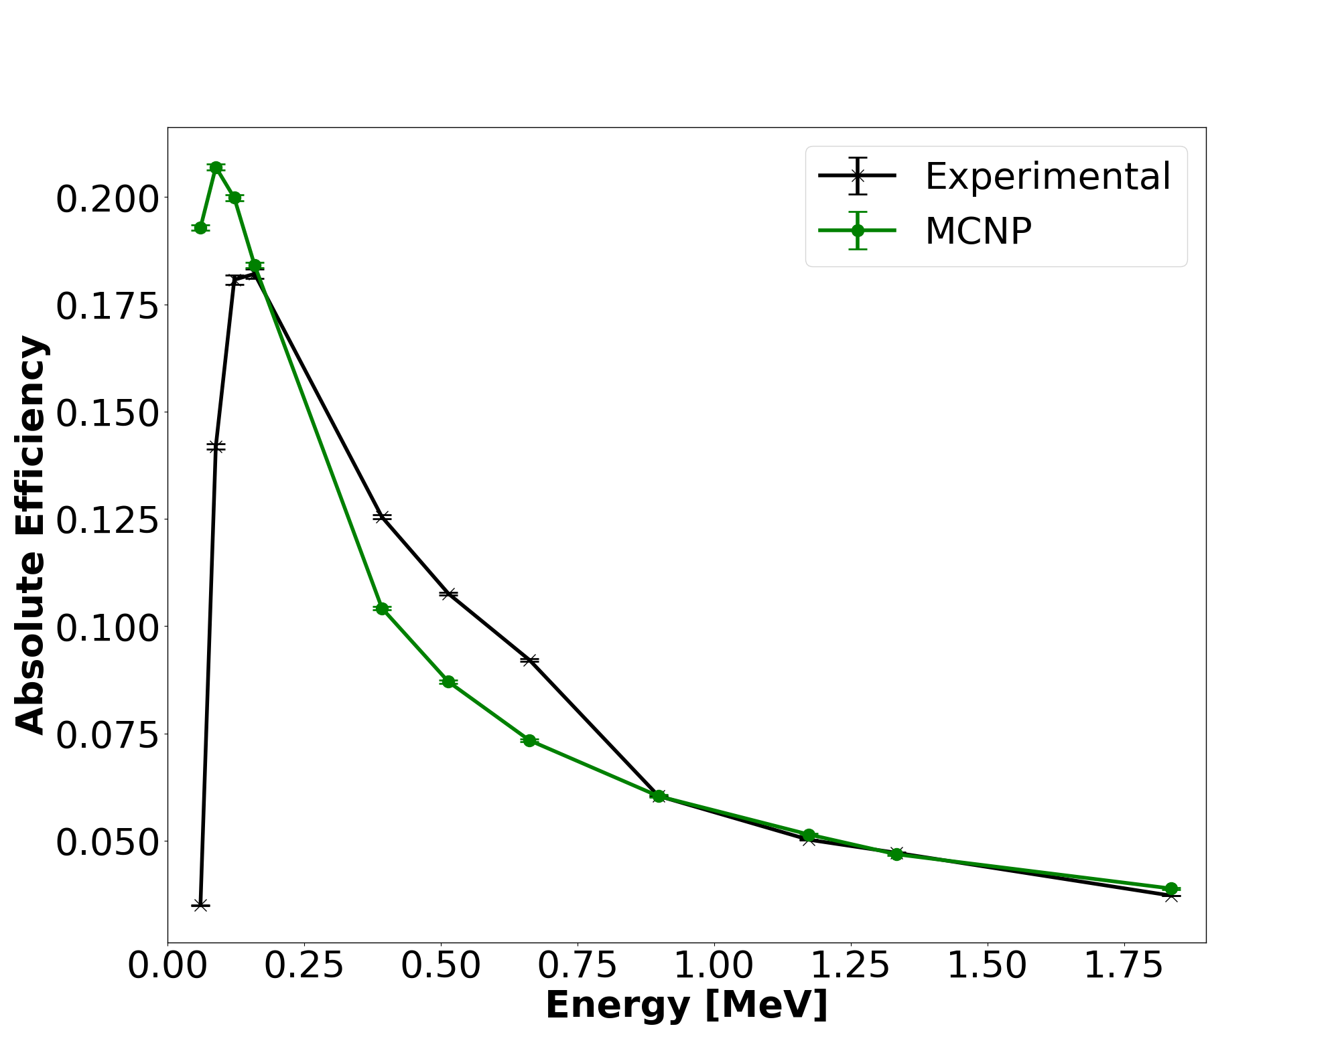
Position 1
Avg Rel Error: 52.1%
Max Rel Error: 451%
Min Rel Error: 0.06%

Slide 11
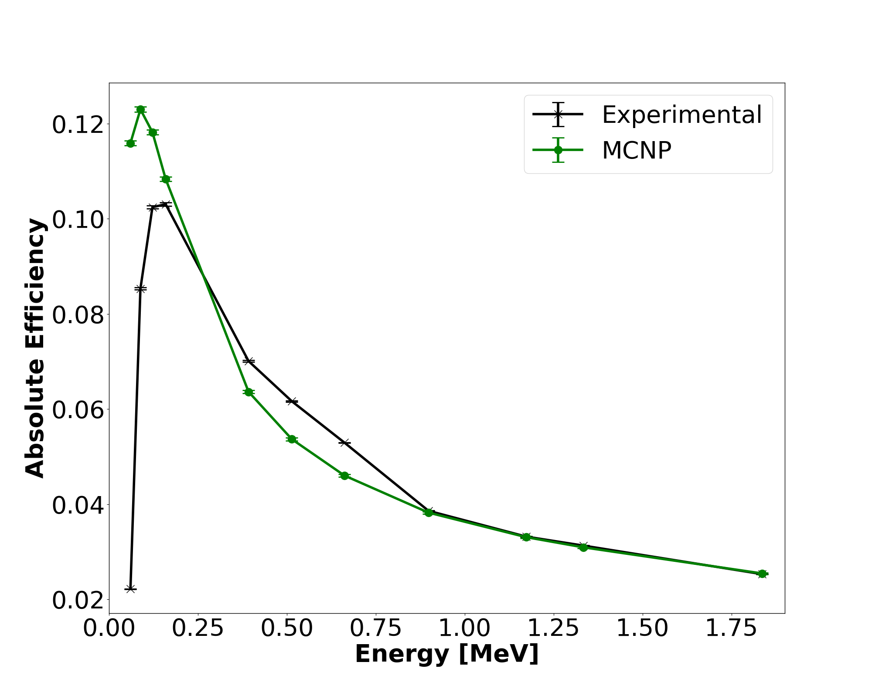
Position 2
Avg Rel Error: 47.8%
Max Rel Error: 423%
Min Rel Error: 0.58%

Slide 12
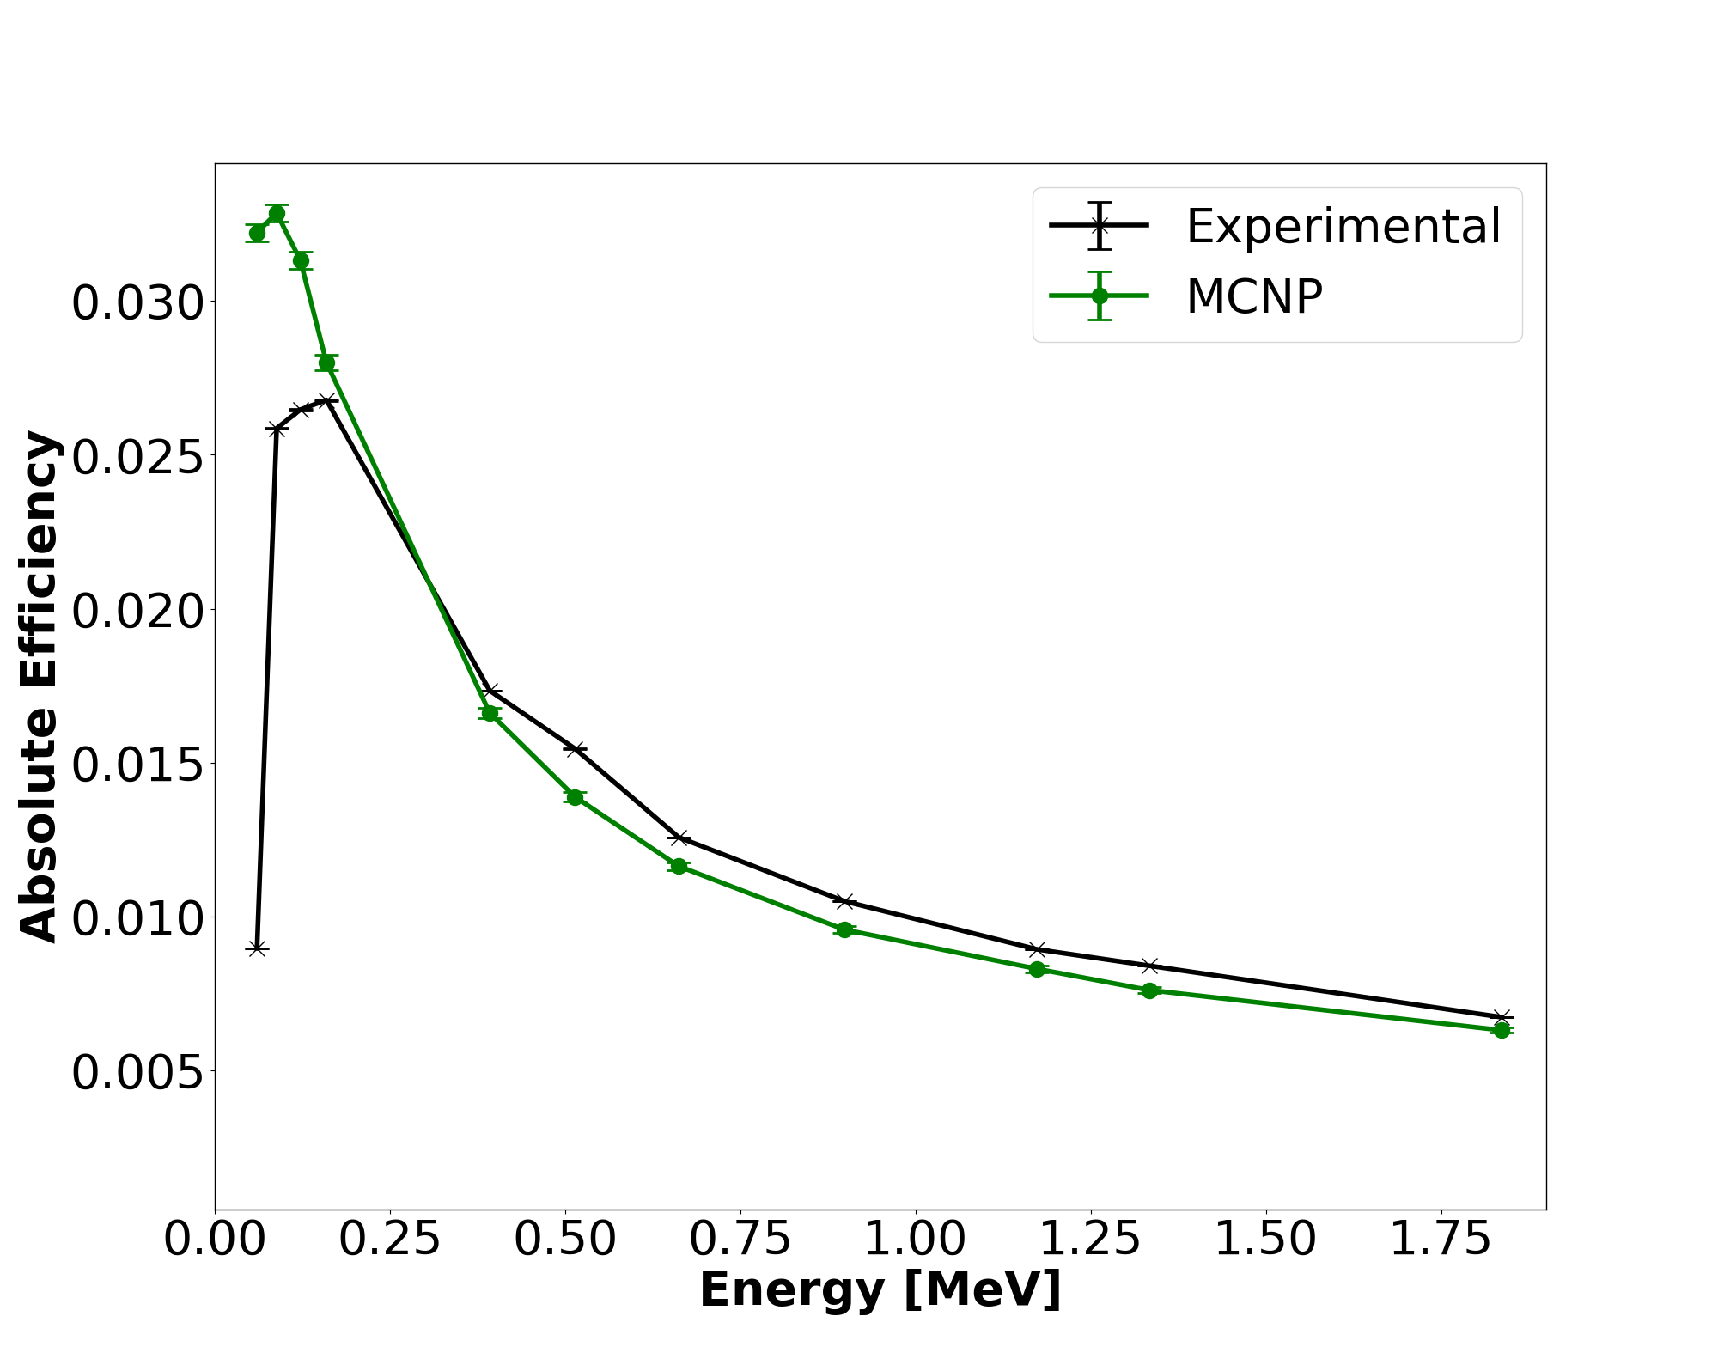
Position 3
Avg Rel Error: 32.9%
Max Rel Error: 259%
Min Rel Error: 4.16%

Slide 13
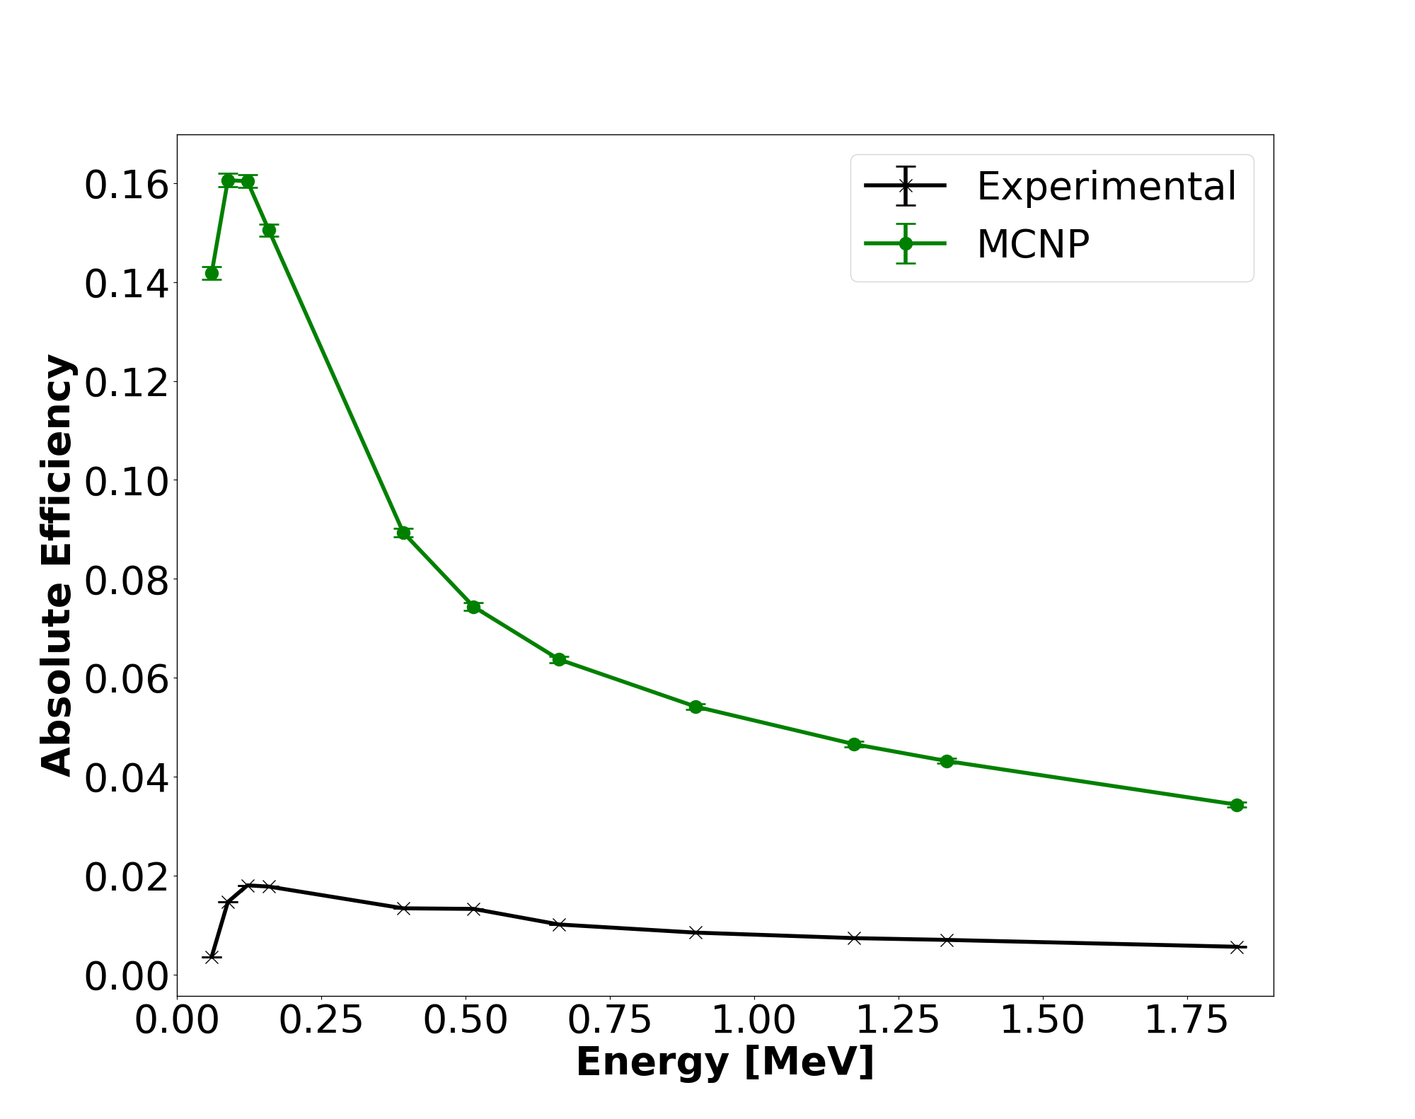
Position 4
Avg Rel Error: 910%
Max Rel Error: 3834%
Min Rel Error: 459%

Slide 14
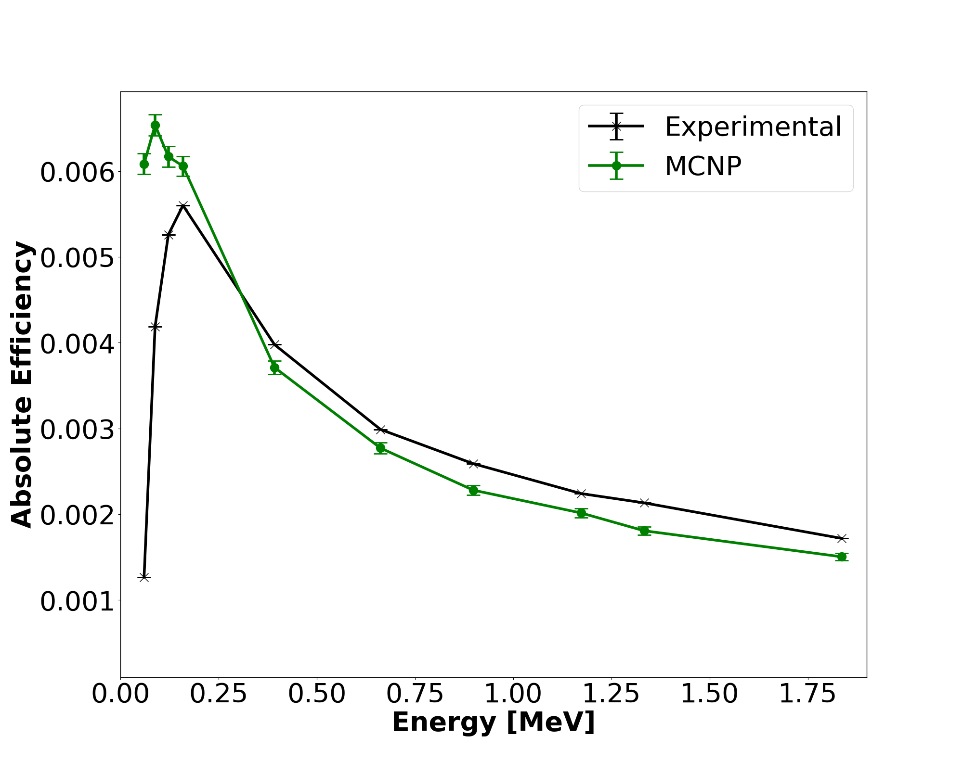
Position 5
Avg Rel Error: 49.7%
Max Rel Error: 380%
Min Rel Error: 6.69%

Slide 15
Optimized Positions
Parameter | Initial Value | Position
 |  | 1 | 2 | 3 | 4 | 5
Outer Top Deadlayer [cm] | 0.13 | 0.738 | 0.739 | 0.739 | 0.739 | 0.739
Outer Sides Deadlayer [cm] | 0.13 | 0.23 | 0.23 | 0.23 | 0.23 | 0.23
Ge Crystal Length [cm] | 8.32 | 7.66 | 7.48 | 7.48 | 7.48 | 7.48
Kapton Window [cm] | 0.010 | 0.110 | 0.110 | 0.110 | 0.058 | 0.110
Inner Top Coaxial Deadlayer [cm] | 3E-05 | 1E-04 | 6E-05 | 6E-05 | 1E-04 | 6E-05
Inner Sides Coaxial Deadlayer [cm] | 3E-05 | 2E-05 | 6E-05 | 7E-05 | 1E-04 | 7E-05
Top Al Casing Thickness [cm] | 0.15 | 0.25 | 0.25 | 0.25 | 0.05 | 0.25
Sides Al Casing Thickness [cm] | 0.15 | 0.05 | 0.05 | 0.05 | 0.25 | 0.25
Ge Crystal Density [g/cm³] | 5.32 | 5.32 | 5.32 | 5.32 | 5.32 | 5.32
- Larger - Smaller
Notes:
90 4684.615 76.92308 333.3333 10.21635 11.37885 50 2000 81 1754.386 66.66667 700 66.66667 200 66.66667 200 0.56391 0

Slide 16
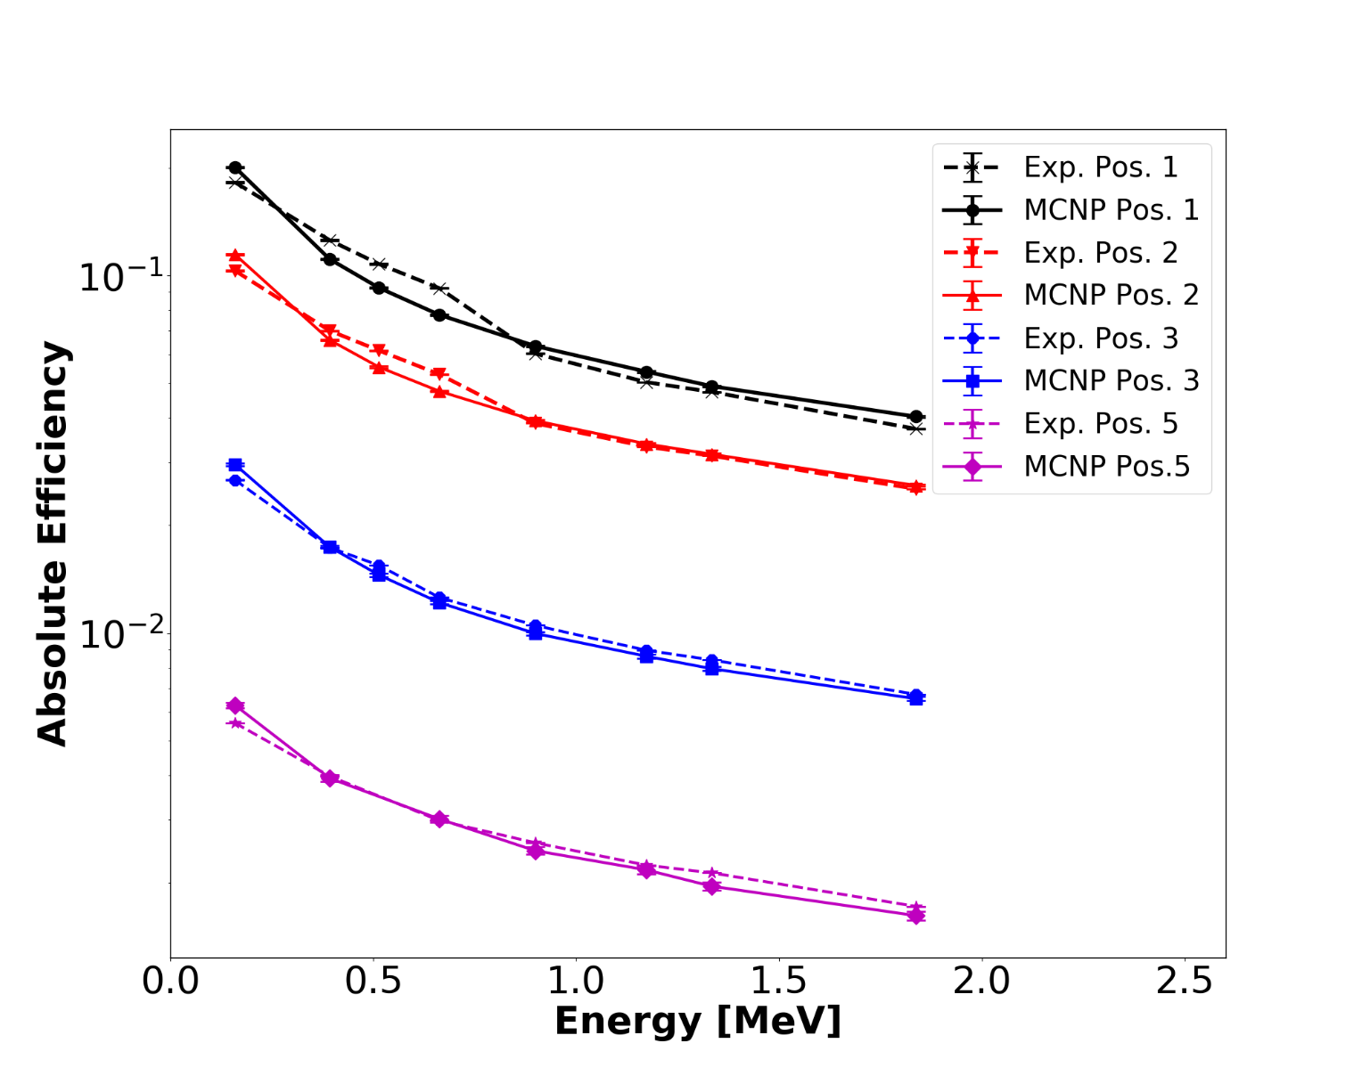
Gamma-Ray Energies above 0.159 MeV
Avg Rel Error: 6.33%
Max Rel Error: 15.8%
Min Rel Error: 0.37%

Slide 17
Gamma-Ray Energies above 0.159 MeV
Position | Average Relative Difference [%] | χ²/ν
1 | 9.44 | 8.67
2 | 5.51 | 3.83
3 | 4.66 | 2.36
5 | 5.73 | 2.91

Slide 18
Conclusion
The brute-force optimization method can represent the efficiency between energies of 0.159-1.836 MeV with a relative difference less than 10%
Best results for sources centered and above the detector
Poor results for energies below 159 MeV
Further evaluation of internal components is required

Slide 19
Future Work
Reach a relative percent difference of less than 1%
Increase adjustable parameters/more realistic
Obtain more information about internal components of the HPGe
Gather more experimental data for comparison
Include more realistic radiation transport physics to reproduce experimental spectra
Apply automated optimization code to other detectors.
Explore other means for optimization
Stochastic optimization

Slide 20
Summary
Project Goals
Experimental Setup
MCNP Model
Automated Parametric Optimization
Results
Conclusions
Future Work

Slide 21
Acknowledgements
Automated optimization code, Mr. Robert Torzilli, AFIT
Provided project assistance, Captain James Bevins, AFIT
Provided experimental data, Lt Colonel Buck O’Day, AFIT
HPGe template provided by, Captain James Bevins, AFIT; Mr. Will Kable, LBL

Slide 22
Disclaimer
The views expressed in this article are those of the authors and do not reflect the official policy or position of the United States Air Force, Department of Defense, or the U.S. Government.

Slide 23
References
[1] R. M. Keyser, "Resolution and Sensitivity as a Function of Energy and incident Geometry for Germanium Detectors," Nuclear Instruments and Methods in Physics Research Section B: Beam Interactions with Materials and Atoms, vol. 213, pp. 236-240, 2004.
[2] R. G. Helmer, R. G. Hardy, V. E. Iacob, M. Sanchez-Vega, R. G. Neilson and J. Nelson, "The use of Monte Carlo Calculations in the Determination of a Ge Detector Efficiency Curve," Nuclear Instruments and Methods in Physics Research A, vol. 511, pp. 360-381, 2002.
[3] W. F. R. R. K. M. D. O. S. C. A. C. A. X. d. S. Guilherme J. de S. Corrêa, "COMPUTATIONAL MODELING OF A HIGH PURITY GERMANIUM," in International Nuclear Atlantic Conference, Belo Horizonte,MG, Brazil, 2011.
[4] G. F. Knoll, Radiation Detection and Measurement, Hoboken, NJ: John Wiley & Sons, Inc., 2010.
[5] D. K. P. S. J. G. M. Jeremy Lloyd Conlin, "Listing of Available ACE Data Tables," Los Alamos National Laboratory, Los Alamos National Laboratory, 2013.
[6] C. G. R. P. R. R. R. W. I. RJ McConn Jr, "Compendium of Material Composition Data for Radiation Transport Modeling," Pacific North Western National Laboratory, Pacific North Western National Laboratory, 2011.
[7] R. E. F. J. K. Shultis, "An MCNP Primer," Department of Mechanical and Nuclear Engineering, Manhattan, KS, 2011.

Slide 24
Questions?

Slide 25
Extra Slides

Slide 26
Previous Work
Manufacturer provided dimensions are often times not sufficient for developing models. ^{[1]}
Published relative differences between experimental and Monte Carlo simulated absolute efficiencies range from around 10% to as low as 0.2%. ^{[2][3]}
Dead layer thickness and the active volume may change over time. ^{[4]}
Notes:
Manufacturer issues
10-0.2% range
Deadlayer/Active Volume changes

Slide 27
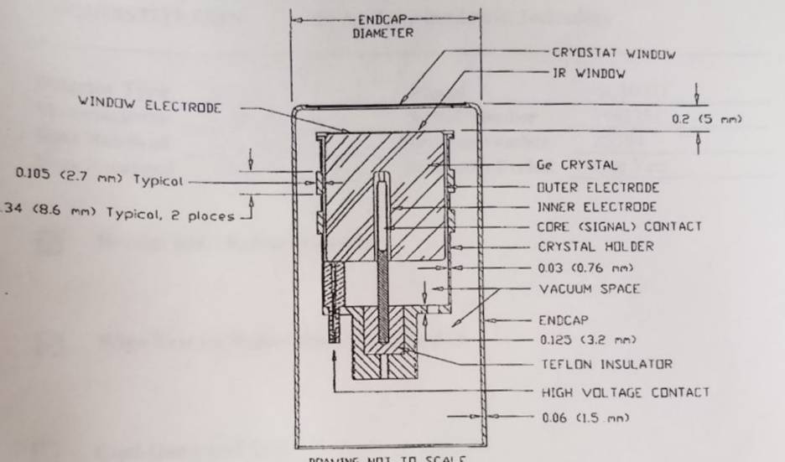
Detector Specifications
Notes:
Spec sheet: nominal values/polishing effects
Approximated clasp location/IR window layout
Ignored: Pin, Teflon, Power cables, top endcap clasp, rounded edges?

Slide 28
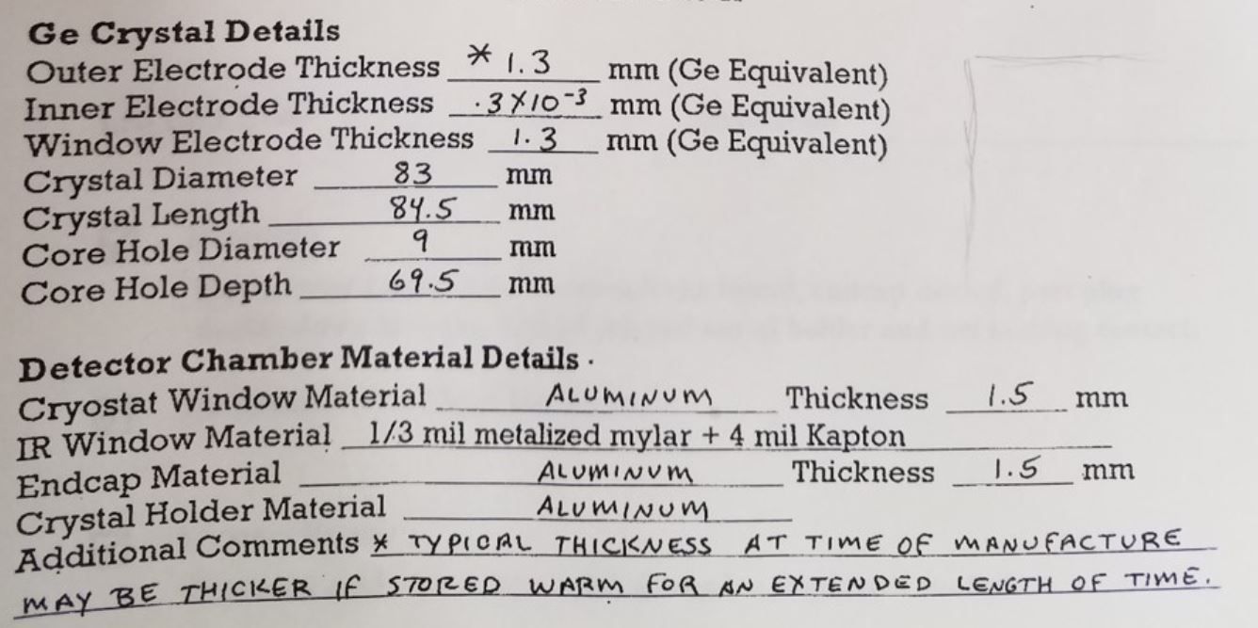
Detector Specifications
Notes:
Outer electrode – Lithium(n+)
Inner Electrode – Boron (p+)

Slide 29
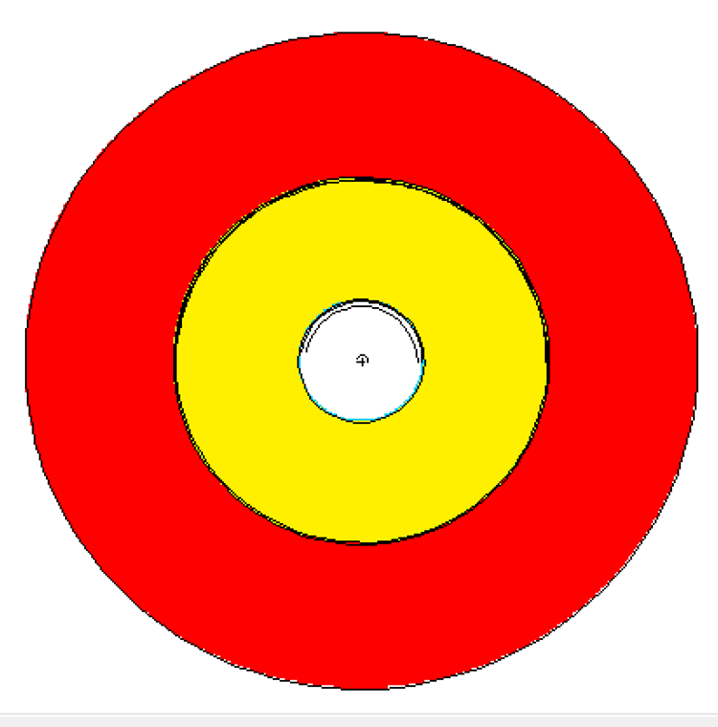
Geometry
Top View:

Slide 30
Materials
Material | Density [g/cm³] | Component(s)
Mylar | 1.38 | IR Window
Aluminum | 2.7 | Detector Housing and Casing
Germanium | 5.32 | Ge Crystal
Lithium | 0.534 | Outer Deadlayer
Boron | 2.73 | Inner Deadlayer
Copper | 8.96 | Shield Lining
Tin | 7.31 | Shield Lining
Kapton Film | 1.42 | IR Window
Air | 0.001224 | Shielding Chamber
Lead | 11.34 | Shielding
Acrylic Glass | 1.19 | Source Encapsulation
Vacuum | --- | Coaxial Space
* All materials from LANLs ACE Data Tables, or PNNLs Compendium of Material Composition Data for Radiation Transport Modeling

Slide 31
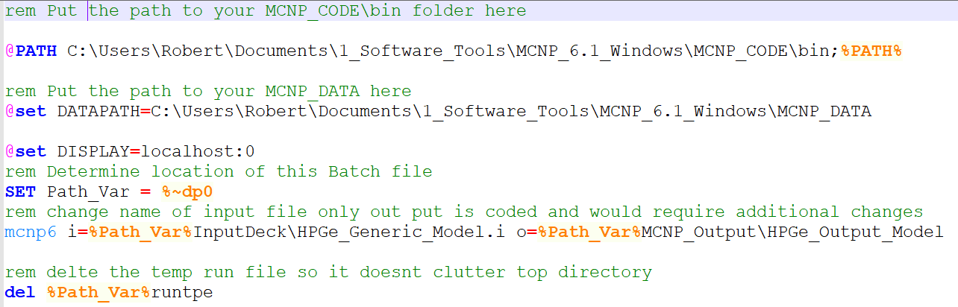
Batch Files

Slide 32
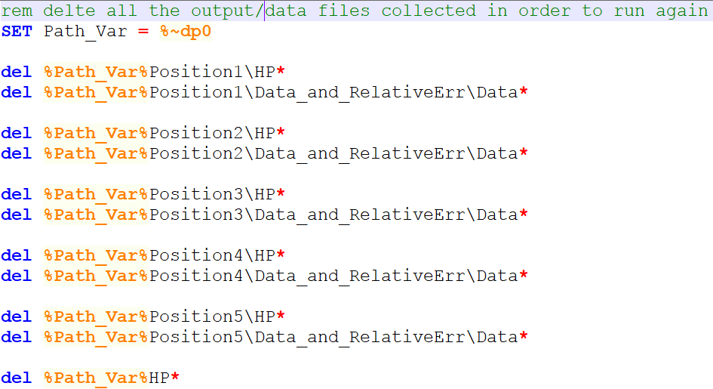
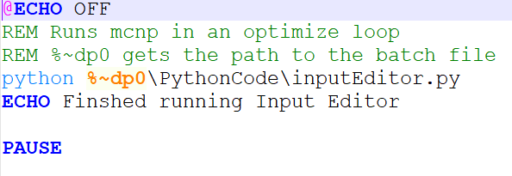
Batch Files
Notes:
Even if the user wants to simply duplicate running this file they will need to alter the runMCNP.bat with their datapath to their mcnp data and mcnp bin folders.
First 100 lines of code involves heavy commentary and variables the user would have to alter.
The user also has to edit the runMCNP.bat file if they change the name for the mcnpModel

Slide 33
Python Code
User Changes
User Defined Input/Output Files
Edit/Merge MCNP Input Decks
Create Output Files
Execution (Optimization):
Alter Model
Compare Values
Relative Difference
Chi-Squared
Create New Input Model (Repeat)
Plotting
Notes:
Manufacturer issues
10-0.2% range
Deadlayer/Active Volume changes

Slide 34
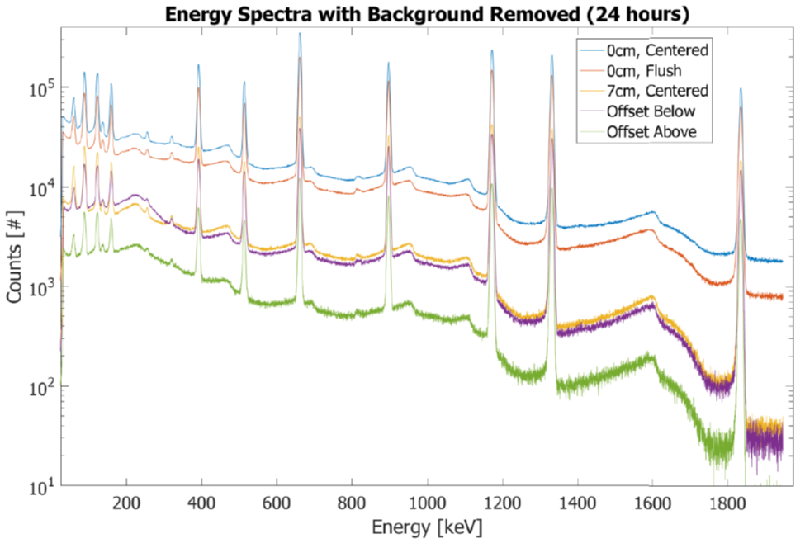
Reasons for Possible Error
Notes:
Lower energy photons are more sensitive to attenuation
Between 200-500 keV includes both the: Backscatter and annihilation peak
Backscatter – recoiled Compton scattered photon
Annihilation – 0.511 MeV photon from pair production/positron annihilation
Knolls: backscatter peak @ 184 keV for Cs-137, Compton Edge @ 662-184 = 477 keV

